Slide 1
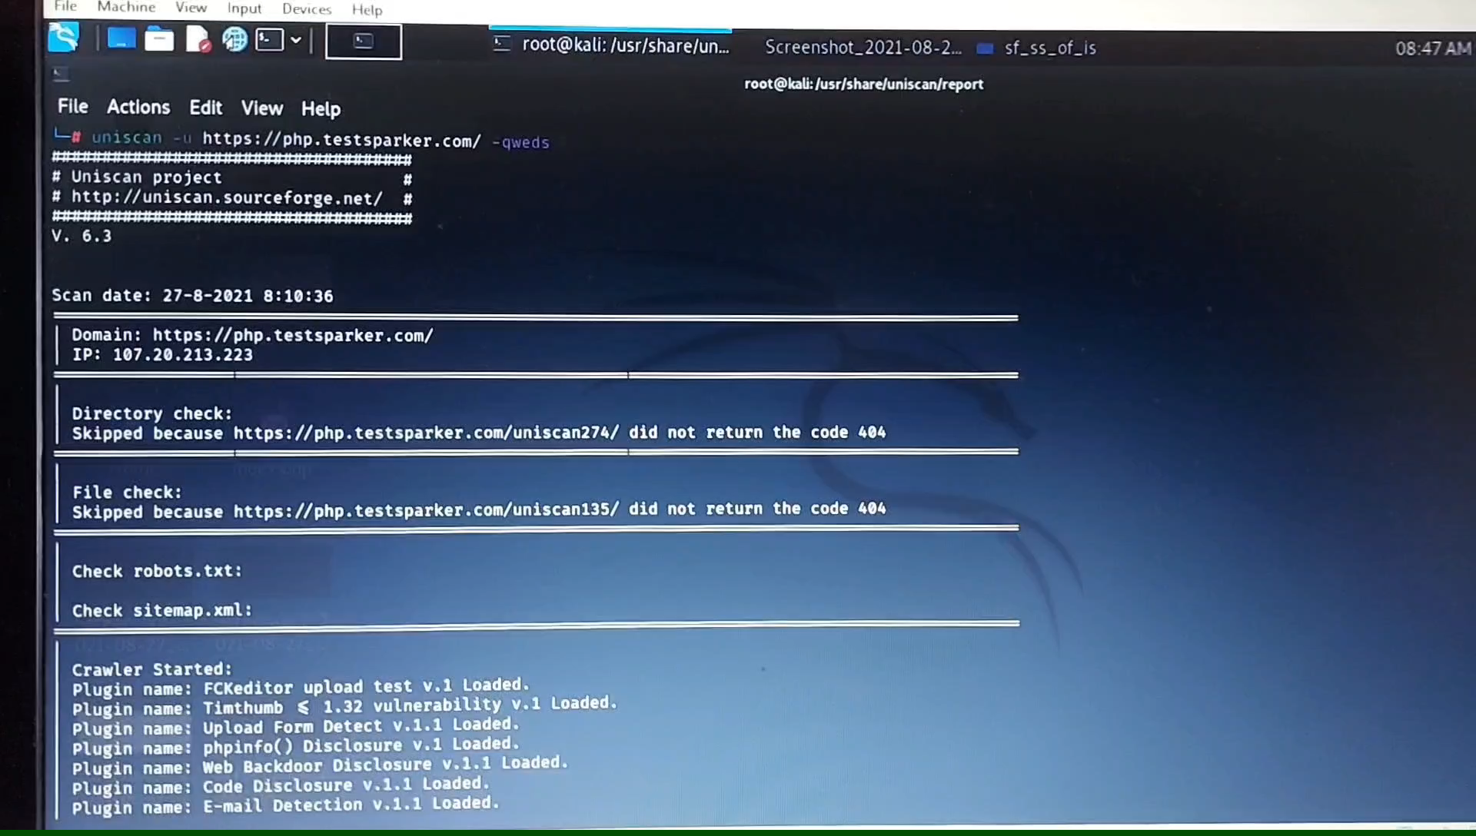
TASK 3 : continue(video) vibhuti patil

